Slide 1

Naïve Bayer Classifier for Spam Comment Detection
Adilet Masalbekov - 301283691
Arcan Caglayan - 301316211
Muhammed Ikbal, Ekinci - 301309283

Slide 2

Introduction & Overview
Introduction:
In the age of digital communication, effectively identifying spam comments is crucial for maintaining the quality of online discourse. Our project uses advanced text analysis and machine learning techniques to automate the process of spam detection, ensuring a cleaner and more valuable online interaction space.
Overview:
Data Source: "Youtube01-Psy.csv" containing 350 user comments.
Key Techniques: Count Vectorization and TF-IDF Transformation for text processing; Multinomial Naive Bayes for classification.
Evaluation: Cross-validation and testing with a separate dataset.

Slide 3

Data Loading and Basic Exploration
Introduction:
The foundation of any data analysis project lies in efficiently loading and understanding the dataset. This initial phase sets the stage for all subsequent analyses and insights.
Overview:
Data Loading: Used pandas to import "Youtube01-Psy.csv", a dataset containing 350 online comments.
Basic Exploration: Conducted to gain initial insights into the dataset's structure and content.
Key Steps: Examining column types, checking for missing values, and understanding the distribution of classes (spam vs. non-spam).
Outcome: Identified 'CONTENT' and 'CLASS' as primary columns for analysis, confirmed a balanced dataset with no missing values.

Slide 4
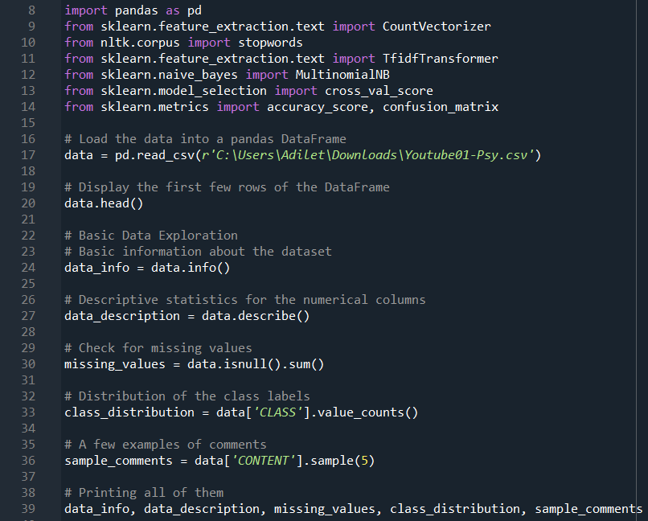
Part 1: Data Loading and Basic Exploration

Slide 5

Data Preparation & Transformation
Introduction:
Transforming raw data into a format suitable for machine learning is a critical step in ensuring the accuracy and effectiveness of the model. This part of the project focuses on processing and preparing textual data for analysis.
Overview:
Feature Selection: Identified 'CONTENT' (text of comments) and 'CLASS' (spam or non-spam labels) as key columns.
Text Vectorization: Used CountVectorizer to convert text data into numerical format, producing a matrix of token counts.
TF-IDF Transformation: Applied TfidfTransformer to the count matrix to reflect the importance of words in the dataset.
Data Shaping:
Reshaped data to reflect TF-IDF scores, maintaining the same feature dimensions.
Converted the transformed data into a DataFrame for ease of handling.
Data Splitting: Shuffled the dataset and split it into training (75%) and testing (25%) sets, preparing it for model training and evaluation.

Slide 6
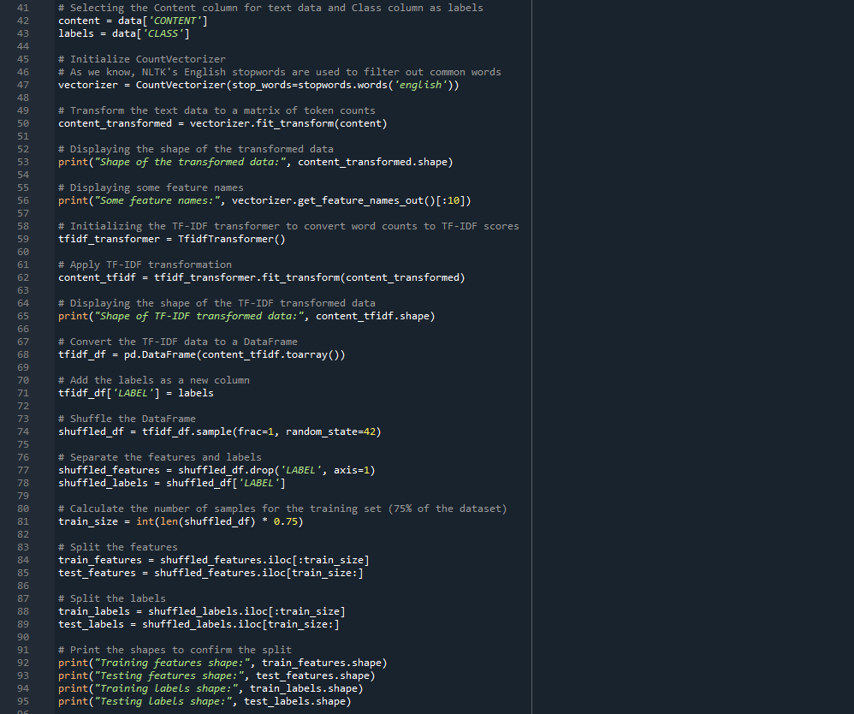
Part 2: Data Preparation and Transformation

Slide 7

Model Training, Evaluation & Testing
Introduction:
This phase is crucial for building and assessing the machine learning model. It involves training the model on preprocessed data, evaluating its performance, and testing its predictive capabilities with unseen data.
Overview:
Model Training: Trained a Multinomial Naive Bayes classifier, a popular choice for text classification tasks, using 75% of the dataset.
Cross-Validation: Performed 5-fold cross-validation to estimate the model's effectiveness, obtaining an average accuracy score.
Model Testing:
Predicted class labels for the test set (25% of the dataset).
Calculated the accuracy of the model on the test set to assess its performance.
Generated a confusion matrix to visualize the model's true positive and negative rates, as well as its error types.
New Data Testing: Tested the model's prediction ability on new, manually crafted comments, demonstrating its real-world applicability.

Slide 8
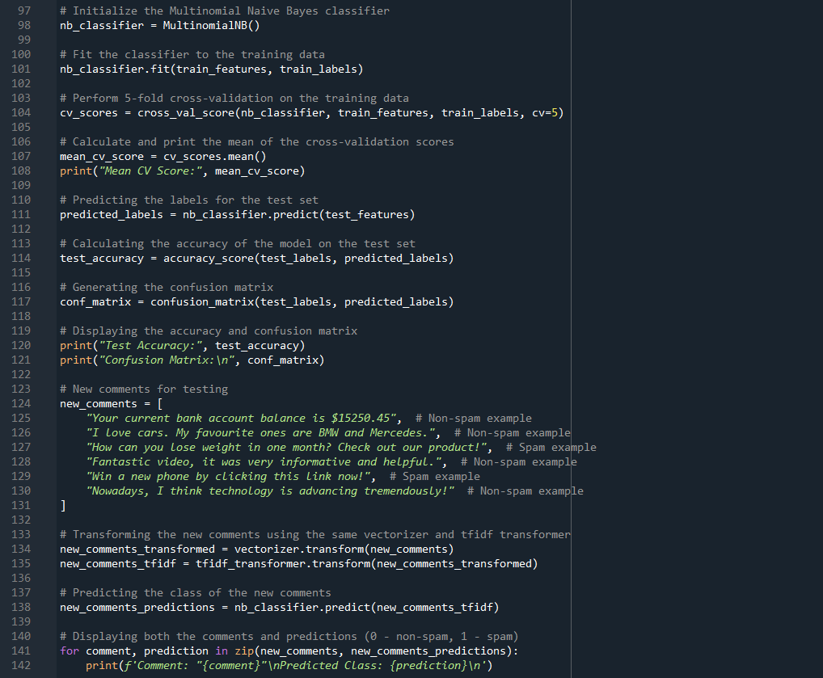
Part 3: Model Training, Evaluation & Testing

Slide 9

Results & Insights
Key Results:
Data Readiness: Successfully loaded and explored the dataset, ensuring no missing values and a balanced distribution of spam and non-spam comments.
Feature Extraction: Transformed textual data into a numerical format suitable for machine learning, using CountVectorizer and TfidfTransformer.
Model Performance:
Achieved a mean cross-validation score of approximately 93.87%, indicating strong model reliability.
Demonstrated high accuracy on the test set with a score of 95.45%.
The confusion matrix revealed the model's effectiveness in distinguishing spam from non-spam, with minimal misclassifications.
Real-world Testing: Successfully classified new comments, effectively identifying both spam and non-spam with high accuracy.

Slide 10
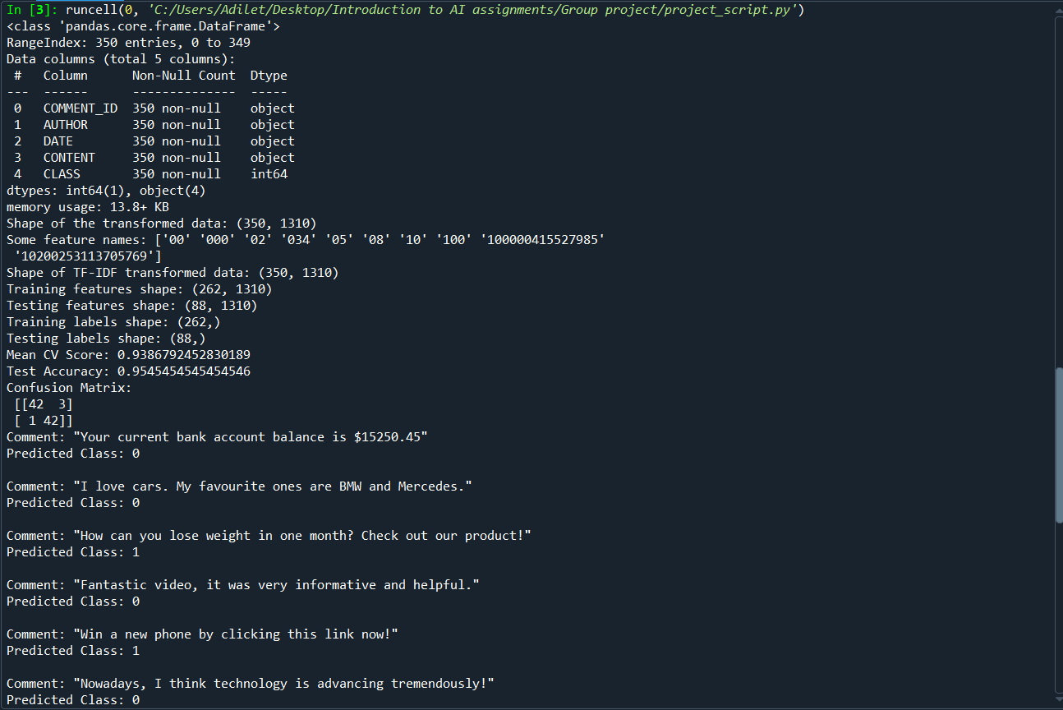
The output of the code

Slide 11

Conclusions
Conclusions:
The Naive Bayes classifier is highly effective in classifying comments as spam or non-spam.
High accuracy in both cross-validation and test sets indicates robust model performance.
Overall Conclusion:
Our project demonstrates a strong application of text classification in identifying spam comments, with high accuracy and effectiveness. The results show that the model we built can reliably differentiate between spam and non-spam comments, making it a valuable tool for moderating or analyzing online content.

Slide 12

Q&A
Thank you For Listening

